Slide 1
NBA: Defining Players by Functionality
Avinash Daniel, Olusegun Omotunde, Justin Peter, Jaryt Salvo
Notes:
Segun

Slide 2
Research Question
How can we operationalize players based on their statistics?
Notes:
Segun

Slide 3
Methodology
Determine clusters using three clustering algorithms on two sets of data:
Attempts & Made (A&M)
Percentages (Perc)
Notes:
Segun

Slide 4
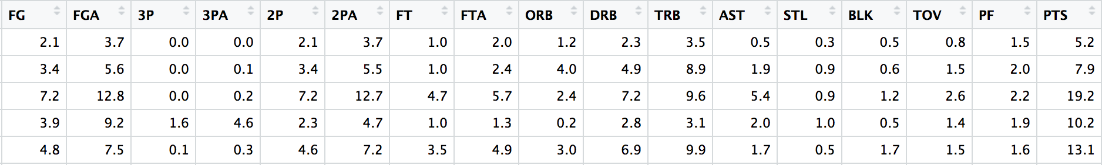
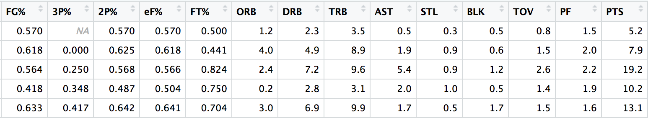
Our two Datasets
Attempts & Made
2) Percentages
Notes:
Segun

Slide 5
Model Building
Clustering Algorithms
Model Based
K-Means
Hierarchical Clustering
Potential Final Models
Models for A&M dataset suggests 4-clusters
Models for Perc dataset suggests 3-clusters
Notes:
Avinash

Slide 6
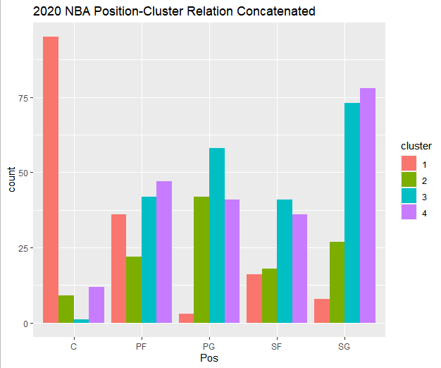
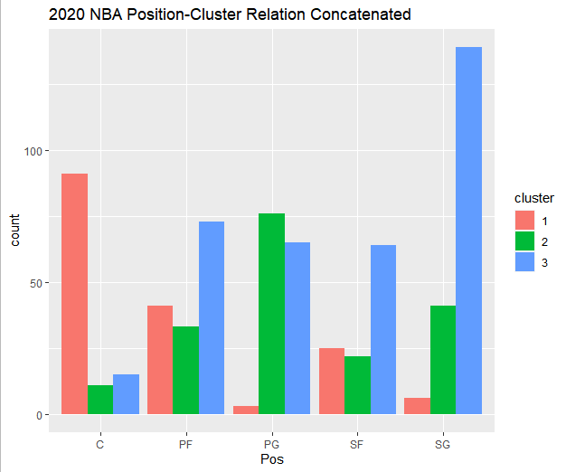
Model Comparisons: Clusters & Positions
Confirmation of suspicion that positions don’t foretell function.
Close relationships:
Cluster 1 & C
Cluster 3 & SG
Notes:
Jaryt

Slide 7
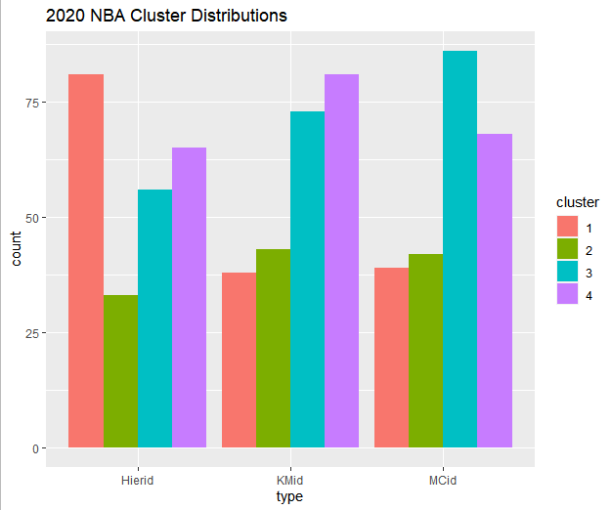
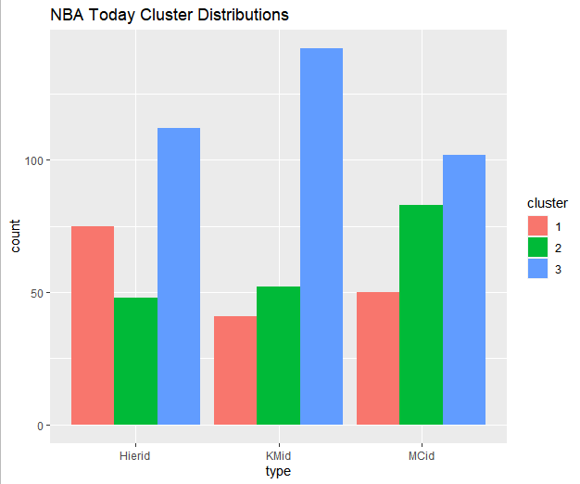
Model Comparisons: Cluster Distributions
Perc Hierarchical Clusters have least count of 2’s.
Perc Model Based Cluster have least count of 3’s.
Kmeans have least equal distribution of clusters.
Notes:
Jaryt

Slide 8
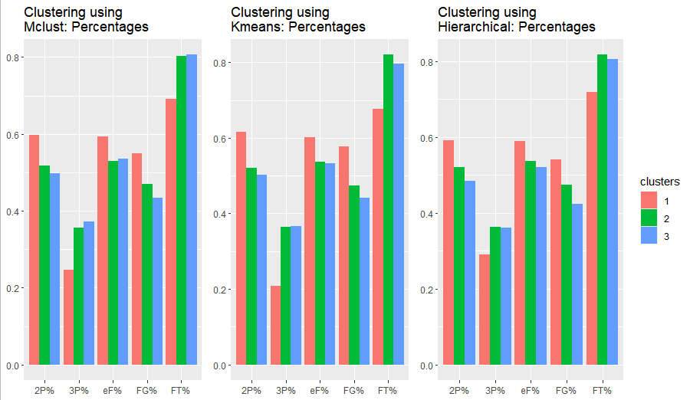
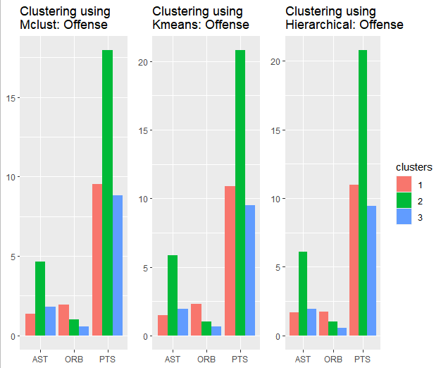
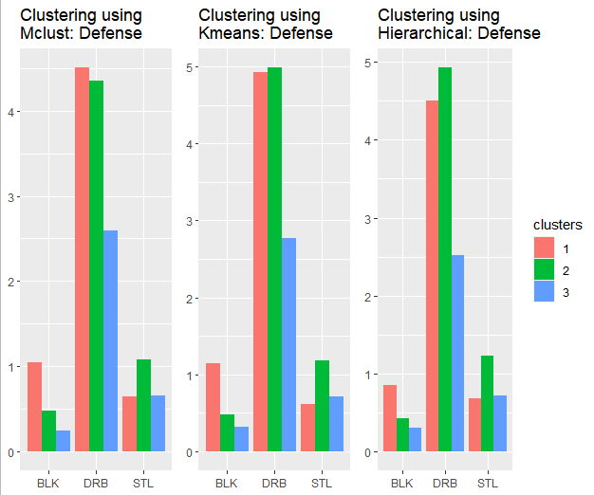
3-Cluster Model
Notice cluster statistics are near-identical for each methodology.
Notes:
Avinash

Slide 9
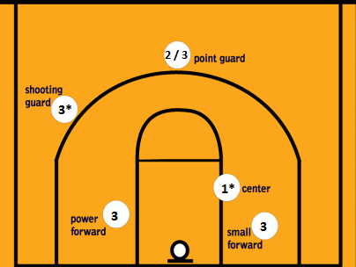
Final Model Functionalities
** Numbers represent the most likely cluster. Numbers with stars have higher likelihood.
Cluster 1 =
In-the-Paint
Cluster 2 =
Generals
Cluster 3 =
Versatiles
Notes:
Justin

Slide 10
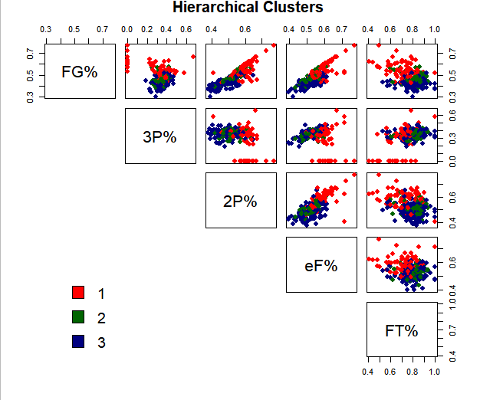

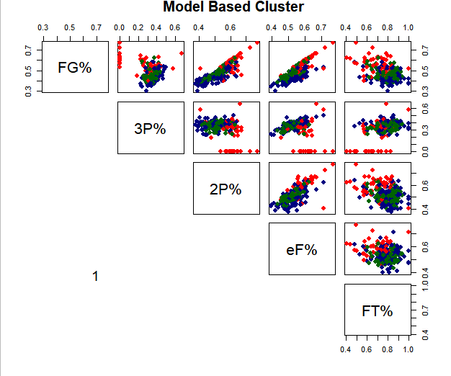

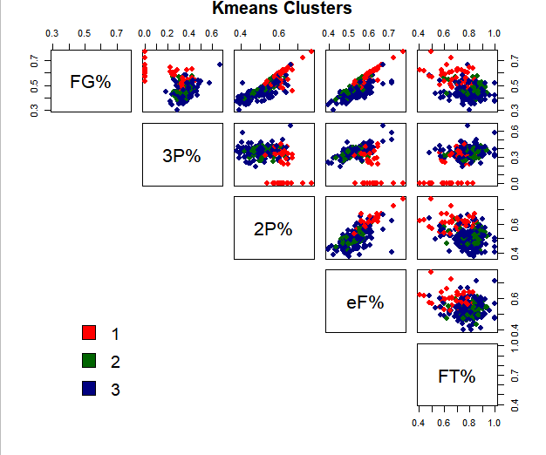

Cluster Visuals
Cluster areas are similar for each methodology.
Differences occur in perimeters.
Notes:
Jaryt

Slide 11
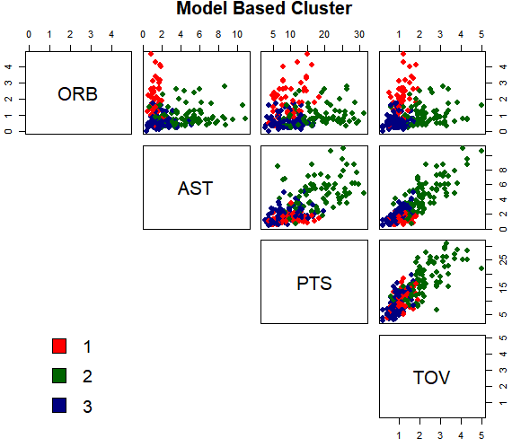
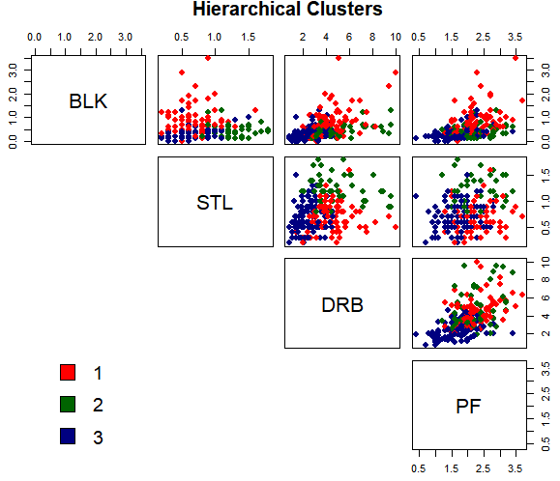
More Cluster Visuals:
In-the-Paints: High rebounds and blocks.
Generals: High points, assists, and steals.
Versatiles: if-else category.
Notes:
Jaryt

Slide 12
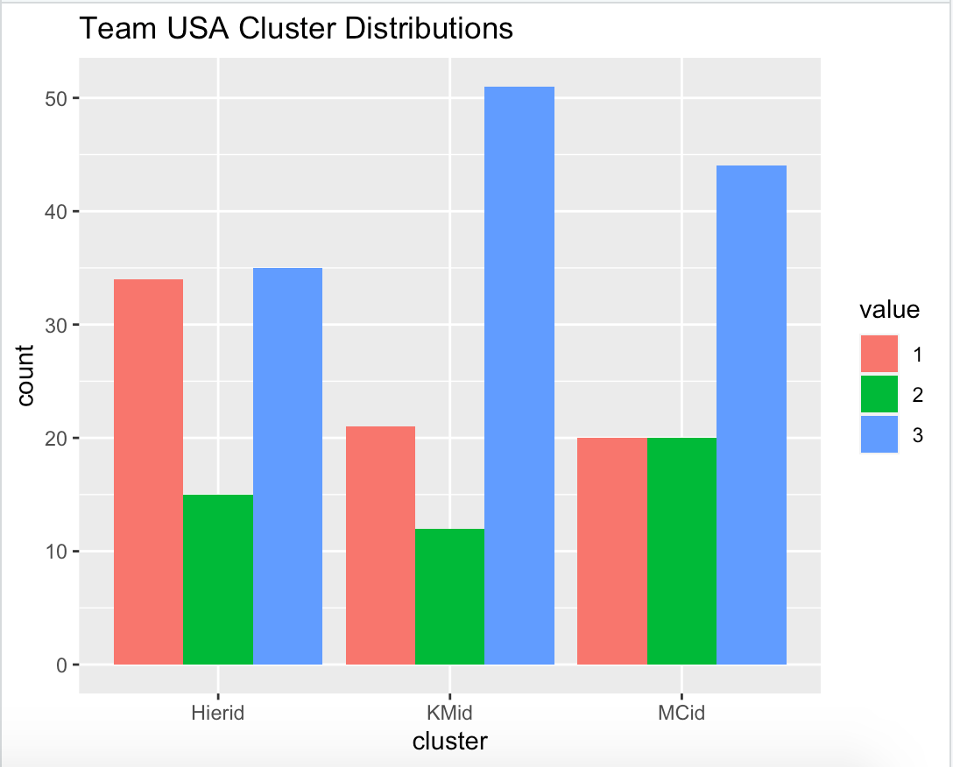
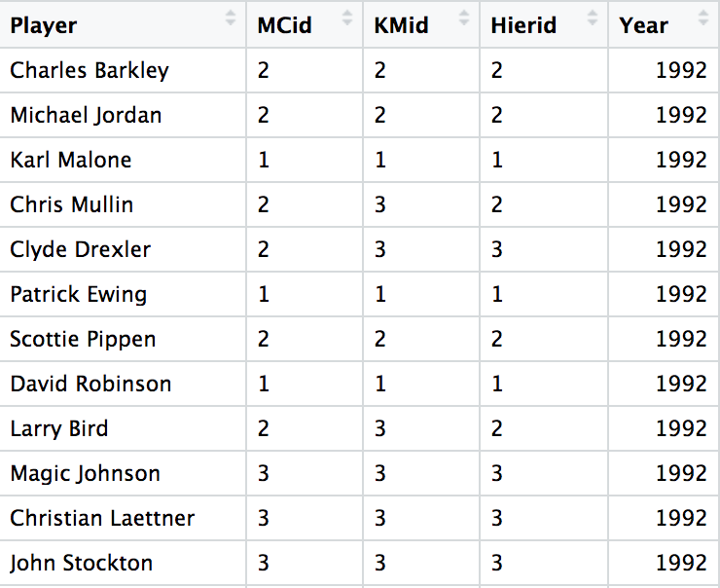
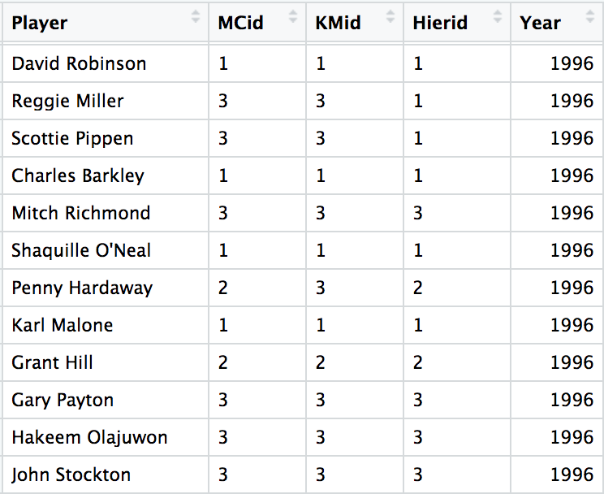
Olympics
Olympics played once every four years
Data from 1992-2016
2020 canceled due to Covid
Notes:
Justin

Slide 13
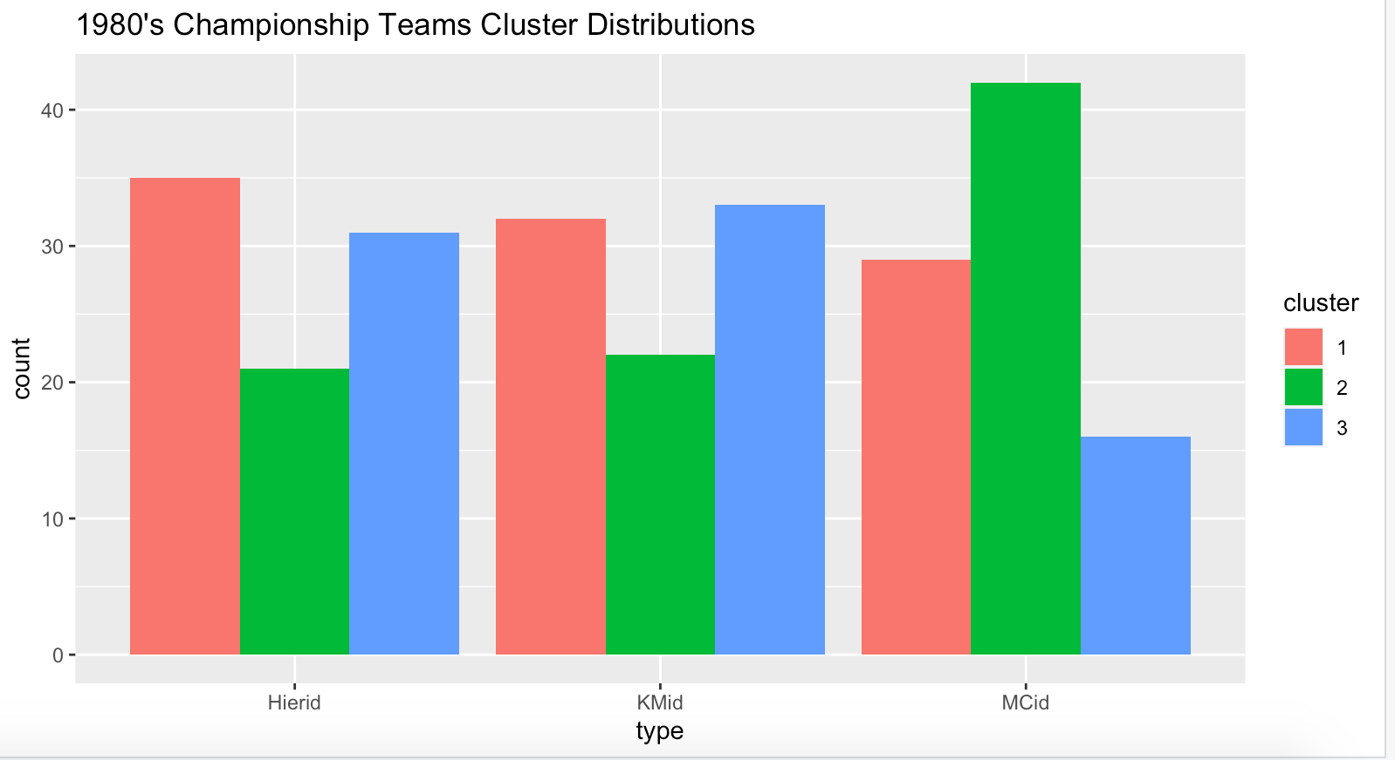
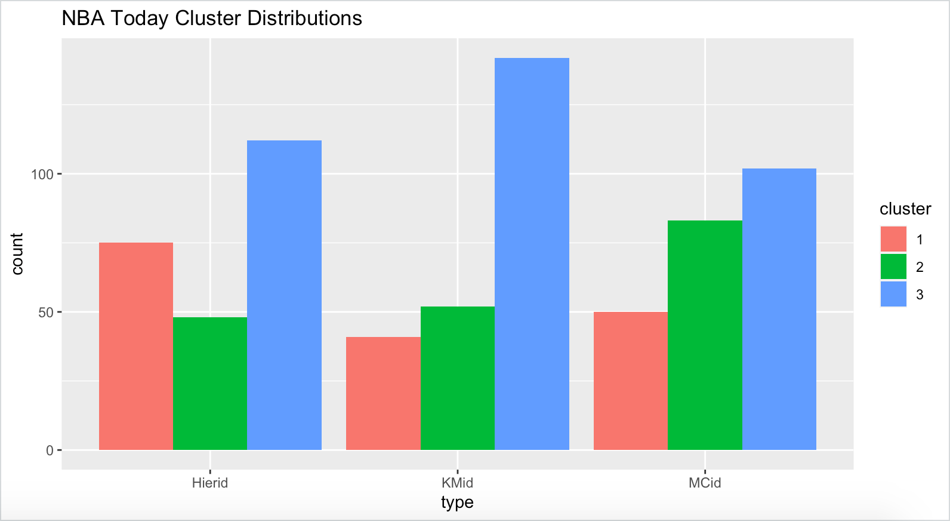
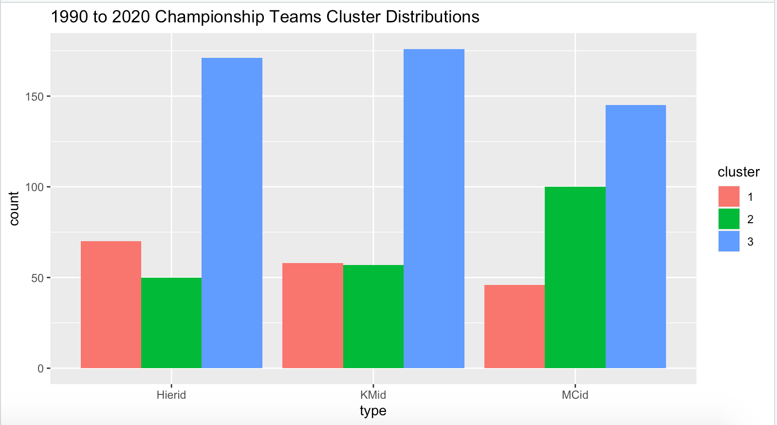
NBA Championship Teams
Number of Championships:
Lakers - 10
Bulls - 6
Celtics, Spurs - 5
Warriors, Pistons, Heat - 3
Rockets - 2
Cavaliers, Raptors, Mavericks, 76ers - 1
Notes:
Avinash

Slide 14
Limitations and Resources
Limitations
Accuracy Measures?
Functions are time-specific
Supervised vs Unsupervised Clustering
Resources
Notes and Slides from Dr. Sarkar
https://thevi5ion.wordpress.com/2017/07/13/classifying-nba-players-using-machine-learning-in-python/
https://medium.com/ds3ucsd/clustering-nba-players-python-sklearn-pandas-50adca24a6b5
https://www.thespax.com/nba/using-machine-learning-to-classify-nba-players-part-ii/
https://www.basketball-reference.com/leagues/NBA_2021_per_game.html
Notes:
Justin

